Slide 1
Introduction to Assignment Rules: Group Assignment
13 February 2014
Notes:
Guidewire training materials contain Guidewire proprietary information that is subject to confidentiality and non-disclosure agreements. You agree to use the information in this manual solely for the purpose of training to implement Guidewire software solutions. You also agree not to disclose the information in this manual to third parties or copy this manual without prior written consent from Guidewire. Guidewire training may be given only by Guidewire employees or certified Guidewire partners under the appropriate agreement with Guidewire.

Slide 2
Lesson objectives
By the end of this lesson, you should be able to:
Describe the difference between global and default group assignment rules
Describe the basic techniques for working with assignment methods
Write assignment rules that assign objects to groups
This lesson uses the notes section for additional explanation and information. To view the notes in PowerPoint, choose View→Normal or View→Notes Page. If you choose to print the notes for the lesson, be sure to select “Print hidden slides.”

Slide 3
Lesson outline
Assignment basics
Assignment methods
Group assignment

Slide 4


Review: Assignment
Service Request
Claim
Exposure
Activity
Matter
In base application, five assignable types of objects
Objects assigned to group and user in that group
Either explicit or rule-based
Notes:
The concept of assignment in Guidewire applications is basically equivalent to ownership. The user to whom a claim is assigned, for example, is the user who "owns" that claim and who therefore has primary responsibility for it. An entity which can be owned in this way is said to be "assignable".
A user in two groups could receive assignments through either group.
Sometimes it is possible to assign an object to a temporary location before the final user and group have been selected. These locations are only intermediate points in the assignment process. Eventually, every assignable object is assigned to a group and a user in that group.
Any assignable object can be assigned to a group, but temporarily be marked as "Pending Assignment,” awaiting manual assignment by a supervisor.
Activities (and only activities) can be assigned to a group queue (rather than user), awaiting selection by a member of the group.
The entities which exist in the Guidewire out-of-the-box configuration cannot be made assignable if they are not already assignable in the base configuration, but extension entities can be made assignable. Service Requests are also assignable objects (in code) in 8.0.0, but are not assignable in the user interface in the base application. Service Requests will be assignable in the user interface in version 8.0.1.

Slide 5

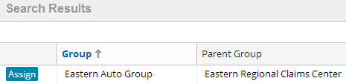

Initiating assignment
Group and user specified
Rules not called
Only group specified
Rules select user
"Automated assignment"
Rules select group and user

Slide 6
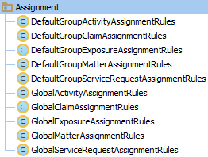
Assignment rule sets
Each assignable entity has two rule sets
Global - primarily to assign objects to groups
Default Group - primarily to assign objects to users in that group
Notes:
Each assignable entity has two rule sets. Assignment is the process of running these rules. Assignment is complete when either the object has a user and group or there are no more rules left to run.
Assignment rules are not used when a user (or queue) and group are specified by the user who is creating or reassigning the item. Assignment rules are used only when there is a group but no specified user, or when there is neither a specified group nor user.
This further study lesson and the next further study lesson following it (User Assignment Rules) focus on claim assignment, with some additional discussion about exposure and activity assignment. Matter assignment is a less common circumstance for developers to grapple with and is not significantly different from claim, exposure, and activity assignment. Therefore, the assignment lessons do not discuss matter assignment in detail.
Service Request assignment is also a less common circumstance, and, in the base application the rules simply assign the Service Request to the claim owner. Service Request assignment in 8.0.0 is not significantly different than claim assignment.

Slide 7


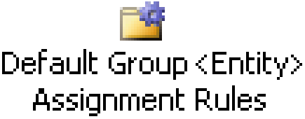
Typical flow of execution
nothing specified
assign to group
Also assigned to user?
yes
no
group specified
assign to user
group and user specified
Done!
Notes:
The diagram above shows a typical flow of execution through assignment rules. The diagram omits processing which is needed for error checking or atypical situations. The omitted processing is discussed later in this lesson and in the "User Assignment Rules" lesson.
There are three assignment circumstances:
Neither a user nor group is specified: In this case, global assignment rules are executed. Typically, global assignment rules assign the object only to a group. Afterwards, default group assignment rules are executed, which assign the object to a user within that group (or a subgroup.) In some cases, global assignment rules can assign the object to a group and a user in the group. In that case, default group assignment rules are skipped.
A group has been specified, but not a user: In this case, only default group assignment rules are executed. These rules assign the object to a user in that group.
A group and user has been specified: In this case, no rules are run. The object is simply assigned to the specified user and group.

Slide 8
Common assignment strategies
Claims
If claim has special issues, assign to group which can handle this type of claim
Otherwise, assign to group based on group type and location
Within group, assign to user based on round-robin
Exposures and activities
If object has special issues:
Assign to group which can handle this type of object
Within group, assign to user based on round-robin
Otherwise, assign object to claim owner
Notes:
The slide above describes some common approaches to object assignment, but it is by no means an exhaustive discussion of how assignment can be or is done.

Slide 9
Lesson outline
Assignment basics
Assignment methods
Group assignment

Slide 10
The CurrentAssignment object
Current Assignment
Every assignable object implements the Assignable delegate, which grants access to the CurrentAssignment object
CurrentAssignment object contains most of the methods for assigning groups and users
All assignment methods discussed in this course belong to this object
Notes:
There are a small number of assignment methods which do not exist on the CurrentAssignment object and instead exist on the root object itself (such as the Activity entity's "assignToClaimUserWithRole" method). However, all of the fundamental assignment methods exist on the CurrentAssignment object.
The CurrentAssignment object also grants access to the values of the owning entities, AssignedGroup and AssignedUser. These values are the same as the values accessed directly from the assigned entity. You might see both ways of accessing this information within sample rules, and both are valid.
For example:
Activity.AssignedGroup == Activity.CurrentAssignment.AssignedGroup serviceRequest.AssignedGroup = serviceRequest.CurrentAssignment.AssignedGroup
…

Slide 11

Exit rule set wrappers
Assignment methods return boolean values
True if assignment was successful
False if appropriate group (or user) could not be found
Place methods in if/exit wrapper to exit rule set as needed
if (assignMethod) {
actions.exit()
}
Notes:
Once you have assigned an object to its final group, there is no reason to continue in the ruleset. Furthermore, there is some risk that a rule further down in the list will reassign your claim to another group in a way that you do not want. Therefore, it is important to execute the actions.exit() method as soon as the object has an appropriate group assignment. By wrapping the assignment method inside the parentheses of an if command, you will exit the ruleset if and only if the assignment is successful. It is best practice to use this approach for every single assignment method in your assignment rulesets, if that method is making a final assignment.
In the example above, ClaimCenter executes the assignGroup method for a given activity. (Recall that assignment methods are on a CurrentAssignment virtual object associated to the object to be assigned.) If the method is able to assign the activity to a group (in this case, the group to which the claim is assigned), then the method returns true and the rule set is exited. If the method is unable to assign the activity to a group (for example, if the claim's assigned group has somehow gotten set to NULL), then the method returns false and execution proceeds with the next assignment rule.
The assignGroup method is discussed later in this lesson.

Slide 12
Common assignment methods
Method | Object | Assigns To...
assignGroup() | Any | The named group
assignGroupByLocation() | Any | Group matching specified location and group type
assignGroupBy RoundRobin() | Any | Group matching specified group type
assign() | Any | The named user (and group)
assignUserBy RoundRobin() | Any | The next user in the group (in a cyclical fashion)
assignUserByLocation() | Any | User matching location
assignToIssueOwner() | Exposure, Activity, Matter | The owner of the claim or related exposure
assignManually() | Any | The group supervisor (who will assign object manually)
assignActivityToQueue() | Activity | The named activity queue
assignByUserAttributes() | Any | A user which matches specified attributes
dynamic assignment | Any | Anything, depending on logic
group
user
Notes:
The first three methods, which assign objects to groups, are discussed in this lesson.
The next six methods, which assign objects to users (or to temporary holding places until a user takes ownership), are discussed in the "User Assignment Rules" lesson.
The final two methods are discussed in the “Assignment Rules: Advanced Assignment” lesson of the ClaimCenter 7.0 Application Configuration course.

Slide 13
Recommended enhancement
It is recommended that you create an enhancement to the Assignable delegate with two methods:
findGroupByName(groupName : String) : Group
findUserByUserName(userName : String) : User
Placing these methods on the delegate makes them available to all assignable objects, including any you add
The next slide gives an example of how to create this enhancement using Queries

Slide 14
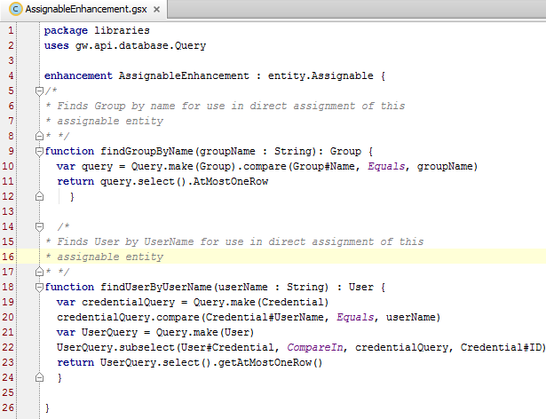
AssignableEnhancement
Notes:
Queries and Gosu Enhancements are discussed in their own lessons in the Configuration Fundamentals course, which is a pre-requisite to this course.

Slide 15
Lesson outline
Assignment basics
Assignment methods
Group assignment

Slide 16
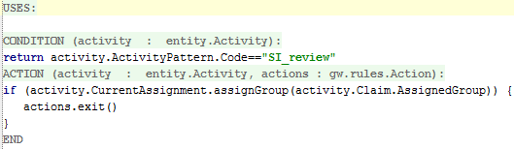
1. Assigning to a specific group
Syntax: object.CurrentAssignment.assignGroup (group)
For example, assign SIU review activities to group that owns activity's claim (Global Activity Assignment)
Notes:
The ruleset shown above is included with the base application. In the rule above, the condition checks to see if the activity was created from the SI review activity pattern.
If it is, then the activity's CurrentAssignment object is referenced to execute assignGroup. The group the activity is assigned to is the group to which the activity's claim has been assigned.
If the assignment is successful, then the rule set is exited. If for some reason the assignment is unsuccessful (for example, if somehow the claim was not assigned to a group), then the next assignment rule is executed.

Slide 17
2. Assigning to group by type and location
Syntax: object.CurrentAssignment.assignGroupByLocation ( groupType, address, directChildrenOnly, group)
Assigns to group:
Of specified group type...
...whose region covers specified address...
...including only direct children groups or all descendent groups...
...beginning with children of specified group
Specified group typically set to null or <entity>.CurrentAssignment.AssignedGroup
Using round-robin
Notes:
It is common to assign objects by group type. For example, complex auto claims would go to a complex auto team (where group type equals "autocomplex"), subrogation activities would go to a subro team (where group type equals "subro"), and so on.
It is also common to have more than one group of a given type in the organization. For example, you might have four complex auto teams, each covering a different part of the country. In this case, you would want to assign complex auto claims to the complex auto team whose region covered some specified address (such as the address of the insured).
This type of assignment is accomplished by the assignGroupByLocation() method. The method first filters out groups who do not have the specific GroupType. Then it looks within those groups for one that covers a specific location.
Typically, the third parameter is set to false. In most cases, you want the method to check all descendent groups, not just the immediate children.
Typically, the fourth parameter is set to either null or to the group which the object is currently assigned to, which is retrieved from "<entity>.CurrentAssignment.AssignedGroup".
Set to null, which defaults to the root group which represents the entire company, when this rule expects to use the top-level of the group hierarchy as the starting point. This will be almost all of the time in the Global Assignment rule sets.
Set to <entity>.CurrentAssignment.AssignedGroup when you want to use any previous group assignment as the starting point. Rules in the Default Group Assignment rule sets always pass this value to assignment functions (whether assigning to users or groups.)

Slide 18
Method step 1: Identify candidate groups
assignGroupByLocation("autonormal", Claim.LossLocation /* west */, false, null)
fast track auto west
fast track auto central
Execution Session
fast track auto east
normal auto west
normal auto central
descendents of...
normal auto east
Acme Insurance
workers' comp national
Notes:
First, the assignGroupByLocation method identifies the "candidate groups" for assignment. It does this by identifying the children of a given group. (This could be either just immediate child groups, if the third parameter is true, or all descendent groups, if the third parameter is false.)
In the example above, the assignGroupByLocation method is used to locate all descendent groups of the root group, Acme Insurance. Therefore, all groups within the group hierarchy are potential candidates for assignment.

Slide 19
Method step 2: Filter by group type
assignGroupByLocation("autonormal", Claim.LossLocation /* west */, false, null)
TYPE
autofast
autonormal
wc
fast track auto west
normal auto west
west
fast track auto central
normal auto central
workers' comp national
REGION
central
fast track auto east
normal auto east
east
Notes:
Next, the assignGroupByLocation method filters out groups which do not have the given typecode. While the “autonormal” typecode is used, you may also use the preferred syntax (GroupType.TC_AUTONORMAL). The typecode is shown above in the code example for instructional purposes.
If no group type is specified (if the first parameter is NULL), then this step is skipped.
If only one group remains, then the object is assigned to that group.
In the example above, the assignGroupByLocation method is to locate a group of type "autonormal". There are only three normal auto groups in the organization. All other groups are eliminated because they do not have the correct group type.

Slide 20
Method step 3: Select by location
assignGroupByLocation("autonormal", Claim.LossLocation /* west */, false, null)
TYPE
autofast
autonormal
wc
fast track auto west
normal auto west
west
fast track auto central
normal auto central
workers' comp national
REGION
central
fast track auto east
normal auto east
east
Notes:
Once groups have been eliminated by group type, a group is chosen from the survivors. The manner in which this search is conducted is discussed on the next slide.
The method looks first for a group whose region includes the location passed into the assignment function.
If no group with a matching location can be found, then the method returns false.

Slide 21

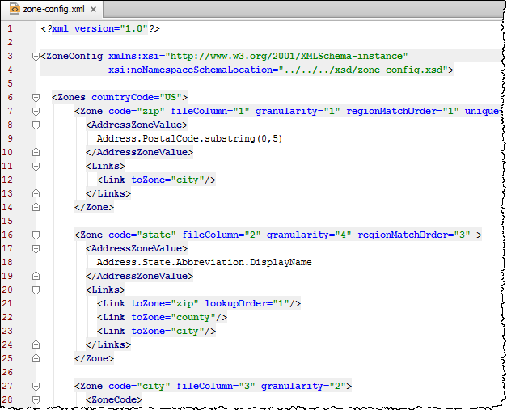
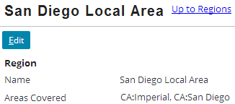
Configuring location selection
Selection by location uses zones and regions
A zone is a type of geographic area
Examples: State, county, city, zip code (US)
Province, FSA, postal code (Canada)
Configured in zone-config.xml (for seven nations)
A region is a collection of specific zone values, configured through Administration tab
Western States
San Diego Local Area
Imperial and San Diego Counties
Notes:
Regions are typically made up of one zone type, but you can create them from multiple types (i.e. Atlanta, Alpharetta (cities) and Fulton (a surrounding county)). Several sample regions for the United States are provided with sample data. Because each nation uses their own system for geographic/location boundaries, ClaimCenter 8.0 comes with seven different zone-config.xml files, each in their own two-character folder under /config/geodata, corresponding to seven nations: 1. United States (US) (Zip Codes, Counties, States). If you know a zip code (“12345”), you can determine the city (“Schenectady, NY”)
2. Canada (CA) (Postal Codes, FSAs, Provinces). A Forward Sortation Area (FSA) consists of the first three characters of a Canadian postal code (i.e. “L6A”). If you know the FSA, you can determine the city (“Maple, ON”).
3. Australia (AU)
4. Germany (Deutschland) (DE)
5. France (FR)
6. Great Britain (GB)
7. Japan (JP)
Each zone type within a country is matched in assignment rules based on the regionMatchOrder property. In the US example from the screenshot above, region matching is done first by zip code, then county, then state. Since there is no regionMatchOrder property on the city zone, city is not considered for location matching. If you look at the zone-config.xml file in the “CA” (Canada) folder, notice that region matching is done first by FSA, then city, then Province.

Slide 22

Selecting a group by location
Colorado level: state contains: Colorado
Colorado
Denver
Denver County level: county contains: Denver, Arapahoe, ...
Denver
Eastern Denver level: postal code contains: 80011, 80012, 80013, ...
80013
Notes:
ClaimCenter starts with most granular type of zone and looks for group with a region covering the given location. (The "given" location is typically either the loss location or the insured's location, but the assignment rule could use any meaningful location.)
If one matching group is found, the object is assigned to that group.
If multiple matching groups are found, the object is round-robined among those groups. (The first object in this location will go to the first group. The next object in this location will go to the second group, and so on.)
If no matching groups are found, ClaimCenter tries next to find a group at the next largest zone type.
Select a group by location example:
Given the example above, ClaimCenter first searches for a group whose postal code matches the claim's location. If a claim's location is postal code 80011, the claim would be assigned to the "Eastern Denver" group.
If there is no group whose region covers the claim's location's postal code, then ClaimCenter next searches for a group whose county matches the claim's location. If the claim's location is in the county of Denver (but not in a postal code covered by the postal-code-based groups), the claim would be assigned to the "Denver County" group.
If there is no group whose region covers the claim's location's county, then ClaimCenter next searches for a group whose state matches the claim's location. If the claim's location is in the state of Colorado (but not in a county covered by the county-based groups), the claim would be assigned to the "Colorado" group.
If ClaimCenter is unable to find any matching group at the largest level of zone type, then the assignment method returns false.

Slide 23

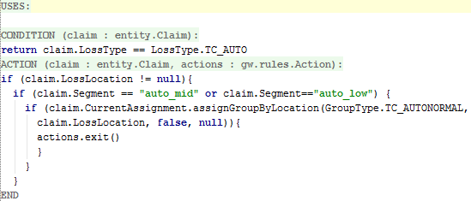
Example: Assign by group type and location
Syntax: object.CurrentAssignment.assignGroupByLocation ( groupType, address, directChildrenOnly, group)
Notes:
The example above is not in the base application.
In the example above, for an auto claim where the loss location is not null and the segment is either "auto_mid" or "auto_low":
The method first retrieves all groups in the hierarchy as candidates (start group is the root group and directChildrenOnly boolean parameter is "false".)
Then, it eliminates all groups which do not have the type "autonormal".
Then, it assigns the claim to the group with the same zip (postal) code as the claim's loss location (or, if no such group exists, the same county...or, if no such group exists, the same state).

Slide 24

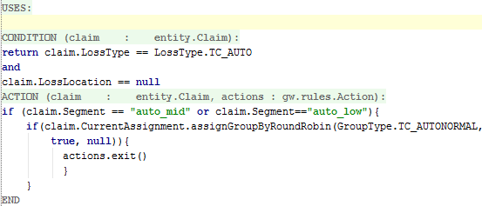
3. Assigning round robin to group by type
Syntax: object.CurrentAssignment.assignGroupByRoundRobin ( groupType, includeSubGroups, group)
Assigns to group:
Of specified group type...
...including all descendent groups or only direct children groups...
...beginning with children of specified group
Specified group typically set to null or <entity>.CurrentAssignment.AssignedGroup
Using round robin
Notes:
The example above is not in the base application.

Slide 25
What if group assignment fails?
nothing specified
assign to group
Was group assigned?
no
Assign to "Default Owner" and root group*
yes
Assigned to user?
yes
no
group specified
assign to user
group and user specified
Done!
Notes:
After global assignment rules have been executed, the assignment engine checks to see if the object was assigned to a group. If the object has not been assigned to a group, then it is assigned to a "dummy" user called Default Owner and the root group of the hierarchy. (If the object was assigned to a group, then assignment proceeds as normal.)
The "Default Owner" is a dummy user used for objects which "fail" group assignment. You cannot log on as Default Owner, and there is typically extra overhead in identifying items assigned to Default Owner and reassigning them to a real user. In general, it is considered bad practice to have a rule set that results in objects being assigned to the Default Owner. This is better handled by having a default assignment rule at the bottom of every Global Assignment rule set, which assigns any uncaught entities to a group that is tasked to handle this situation.
*Technically, the claim will only be assigned to the Default Owner if this is a new claim assignment. If this is a claim reassignment, then group assignment failure will result in the claim remaining owned by the current owner.

Slide 26

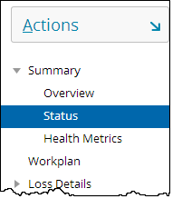

Default owner assignment
If global assignment is successful, object is assigned to user and group
If global assignment is unsuccessful, object is assigned to "Default Owner" and root group

Slide 27
Lesson objectives review
You should now be able to:
Describe the difference between global and default group assignment rules
Describe the basic techniques for working with assignment methods
Write assignment rules that assign objects to groups

Slide 28
Review questions
When a claim is assigned by rules, which two rule sets are typically executed? In what order?
Under what circumstances can a claim get assigned without global claim assignment rules being executed?
What is the CurrentAssignment object?
Why are assignment methods always inside if statements?
What method is used to assign an object to a group in a given location? To a group of a given type?
What are the three "steps" that the assignGroupByLocation method goes through?
What is the "Default Owner" of an object?
Notes:
Answers
1. First, "global" rules are executed. Then, "default group" rules are executed.
2. Possible answers: When the claim is assigned to a specific user; When the claim is assigned to a specific group (and rules are needed only to determine which user in the group to assign the object to).
3. The CurrentAssignment object is an extension to all assignable entities to which all the assignment methods are associated.
4. Assignment methods are always inside if statements because you only want to execute actions.exit() to exit the rule set when the assignment method has succeeded. For example, an assignGroupByLocation method may not be able to find a group of the chosen type. If the assignment succeeds, then the if statement causes control of flow to execute an actions.exit() statement, which exits execution from the rule set. If the assignment fails, then the actions.exit() statement is skipped and execution proceeds to the next rule.
5. Group assignment by location and by type is both done by the assignGroupByLocation method.
6. (1) Identify candidate groups; (2) Filter out groups based on group type; (3) Select group which matches given location at most local granularity.
7. "Default Owner" is a dummy user that objects are assigned to when global assignment rules fail to assign the object to a group.

Slide 29
Notices
Copyright © 2001-2014 Guidewire Software, Inc. All rights reserved.
Guidewire, Guidewire Software, Guidewire ClaimCenter, Guidewire PolicyCenter, Guidewire BillingCenter, Guidewire Reinsurance Management, Guidewire ContactManager, Guidewire Vendor Data Management, Guidewire Client Data Management, Guidewire Rating Management, Guidewire InsuranceSuite, Guidewire ContactCenter, Guidewire Studio, Guidewire Product Designer, Guidewire Live, Guidewire DataHub, Guidewire InfoCenter, Guidewire Standard Reporting, Guidewire ExampleCenter, Guidewire Account Manager Portal, Guidewire Claim Portal, Guidewire Policyholder Portal, ClaimCenter, BillingCenter, PolicyCenter, InsuranceSuite, Gosu, Deliver Insurance Your Way, and the Guidewire logo are trademarks, service marks, or registered trademarks of Guidewire Software, Inc. in the United States and/or other countries.
All other trademarks are the property of their respective owners.
This material is confidential and proprietary to Guidewire and subject to the confidentiality terms in the applicable license agreement and/or separate nondisclosure agreement.
This file and the contents herein are the property of Guidewire Software, Inc. Use of this course material is restricted to students officially registered in this specific Guidewire-instructed course, or for other use expressly authorized by Guidewire. Replication or distribution of this course material in electronic, paper, or other format is prohibited without express permission from Guidewire.
Guidewire products are protected by one or more United States patents.

